Slide 1
Coding the Many-to-Many Relationship
All the relatives are coming to visit

Slide 2


In this video...

Slide 3

Many-to-many recap

Slide 4
Many-to-many recap
A many-to-many relationship requires a join table. Each main table has a primary key. The join table has two foreign keys.
Recipe table
recipe_id | name
1 | Ice cubes
2 | Vegan tacos
Recipe_Category table
Category table
recipe_id | category_id
2 | 1
2 | 2
category_id | name
1 | Mexican
2 | Vegan
Notes:
Primary keys: recipe.recipe_id, category.category_id. Foreign keys: recipe_category.recipe_id, recipe_category.category_id

Slide 5
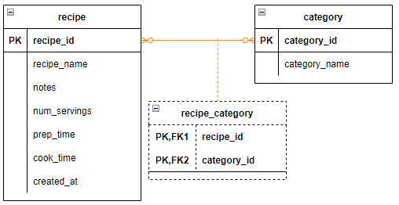
recipe_category join table
The recipe_category table has foreign keys for the recipe ID and the category ID

Slide 6
CREATE TABLE for many-to-many
CREATE TABLE recipe_category (
recipe_id INT NOT NULL,
category_id INT NOT NULL,
FOREIGN KEY (recipe_id)
REFERENCES recipe (recipe_id)
ON DELETE CASCADE,
FOREIGN KEY (category_id)
REFERENCES category (category_id)
ON DELETE CASCADE,
UNIQUE KEY (recipe_id, category_id)
);

Slide 7
The strategy
MySQL won't fill in the foreign key values when we add a row to recipe_category
The user will enter:
The recipe ID
The category name
The application will look up the category ID based on the name
We will use a subquery for this

Slide 8
The SQL
INSERT INTO recipe_category
(recipe_id, category_id)
VALUES (
?,
(
SELECT category_id
FROM categories,
WHERE category_name = ?
)
)
// In the statement
stmt.setInt(1, categoryId);
stmt.setString(2, categoryName);
Subquery

Slide 9

Build the project

Slide 10
The approach
Add the "add category" selection to the menu along with associated methods
Add the service method
Write the add category method in the DAO
Test it!

